Slide 1

Post Processing
Christina Holt
Slides adapted from an HWRF Tutorial Presentation by Tim Brown
Notes:
30 Mins

Slide 2
Overview
Unipost
copygb
Tracker
Visualization
Vertically interpolates model output to pressure levels and computes additional diagnostic variables
Interpolates fields to user-defined grids, and/or combines two domains
Extracts properties of the storm (location, intensity, etc.) from 3D meteorological fields
Generates a variety of images of the forecast

Slide 3
Unified Post Processor (UPP)
Unipost
De-staggers HWRF parent and nest domain output
Computes diagnostic variables
Output in grib1 (HWRF scripts convert to grib2)
MPI parallel code that can take advantage of large numbers of processors
copygb
Interpolates the output from native WRF grids (E-grid) to NWS standard levels and grids (lat/lon)
Combines nest data onto parent domain
Produces GRIB files that can be ingested by most plotting programs (NCL, GrADS etc.)

Slide 4
Unipost Input
Unipost Output
Unipost reads WRF output files (netcdf for HWRF) using WRF I/O package
WRF provides all the unipost required fields by default
Be cautious when editing the WRF registry
Required unipost input fields are outlined in the respective WRF Users’ Guide (NMM or ARW)
UPP has 100s of potential output fields
Complete list of output fields can be found in the ARW or NMM Users’ Guides
Typical examples:
T, Z, Q, U/V, cloud water, ice, rain, and snow on isobaric levels
T, Q, U/V at shelter level
SLP
Precipitation-related fields
Synthetic satellite and radar reflectivity
Radiative fluxes
Cloud-related fields
Aviation products

Slide 5
Synthetic Satellite Products
Satellite fields are generated by using the Community Radiative Transfer Model (CRTM) forward model to transform model-predicted cloud, moisture, and surface fields
Allows for direct comparison of model output to satellite observations
HWRF currently generates synthetic satellite products from a variety of satellites and channels

Slide 6
Vortex Tracker Required Fields
Primary
MSLP
Relative vorticity* at 10m, 850 and 700 hPa
Geopotential height at 850 and 700 hPa
Secondary
Winds (u/v) at 10m, 850, 700, and 500 hPa (required for intensity estimate, too)
*UPP provides absolute vorticity, which is converted to relative vorticity within the tracker

Slide 7
Running Unipost and Copygb

Slide 8
Code Structure
arch/ build scripts
bin/ executables location after building
include/ mod files used for building
lib/ libraries used for building
parm/ control file used to specify which variables to output
scripts/ sample scripts for running UPP (not used for HWRF)
src/ source codes
clean
compile
configure
build scripts

Slide 9
Required unipost.exe Input
WRF Output and 3 other files
HWRF native output: wrfout_d01, wrfout_d02 or wrfout_d03
itag – Specifics on model output
Model output file name
Format of model output
Fcst validation time
Model name
HWRF scripts generate/gather these
hwrf_eta_micro_lookup.dat – binary look-up table for Ferrier microphysics
Control file – specifies output fields/levels
wrf_cntrl.parm
hwrf_cntrl.nosat
hwrf_cntrl.sat
USAGE:
unipost.exe < itag

Slide 10
Unipost Control File: hwrf_cntrl.nonsat
Contents specify the fields/levels for which UPP provides output
(HEIGHT OF PRESS SFCS) SCAL=( 6.0)
L=(11111 11111 11111 11111 11111 11111 11111 11111 11111 11111 11111 10000 00000 00000)
(TEMP ON PRESS SFCS ) SCAL=( 4.0)
L=(11111 11111 11111 11111 11111 11111 11111 11111 11111 11111 11111 10000 00000 00000)
(SPEC HUM ON P SFCS ) SCAL=( 5.0)
Product Description
GRIB packing precision
Columns represent a single model/isobaric level
1 = output
0 = no output

Slide 11
Available Control Files
HWRF provides all the control files required by unipost.exe
The UPP source code (sorc/UPP/parm) provides the wrf_cntrl.parm
The HWRF parm/ configuration directory contains hwrf_cntrl.nosat and hwrf_cntrl.sat{BASIN} files used for HWRF-specific output fields
hwrf_cntrl.nosat includes tracker-related variables
hwrf_cntrl.sat{BASIN}includes basin-specific satellite fields where {BASIN} is a single letter basin identifier

Slide 12
Vertical Coordinates of Output
Output can be interpolated to several vertical coordinates
Native model level
47 isobaric levels
7 flight levels above MSL
914, 1524, 1829, 2134, 2743, 3658, and 6000 m
6 PBL layers
Each averaged over 30 hPa AGL layer
2 AGL levels
1000 and 4000 m (radar reflectivity)
Vertical levels (except for AGL and isobaric levels) are counted from the ground surface up in the parameter control file

Slide 13
Copygb Execution: Generic
Several options for defining horizontal interpolation onto new grid
Pre-defined NCEP standard grids
Grid navigation from unipost
User-defined grids:
Lambert Conformal grid
Polar Stereographic grid
Lat-long grid
USAGE:
copygb.exe –xg“$grid” in.grb out.grb

Slide 14
Copygb for Pre-defined NCEP Grids
An example for NCEP grid 212
Description of NCEP grids is available online at http://www.nco.ncep.noaa.gov/pmb/docs/on388/tableb.html
copygb.exe –xg212 in.grb out.grb

Slide 15
Copygb for Unipost Grids
Unipost creates two ASCII files containing grid navigation information similar to the domain and grid spacing of the model integration domain
copygb_gridnav.txt: Lambert Conformal grid (NMM only)
copygb_hwrf.txt: regular lat/lon grid (ARW or NMM)
Example:
read nav < ‘copygb_hwrf.txt’
copygb.exe –xg“$nav” in.grb out.grb

Slide 16
Copygb for Lambert Conformal Grids
map type (3=LC)
number of points
SW corner (millidegrees)
flag for user-defined grid
copygb.exe –xg“255 3 NX NY STARTLAT STARTLON 8 CENLON DX DY 0 64 TRUELATE1 TRUELAT2” in.grb out.grb
projection true latitude (millidegrees)
Projection center longitude (millidegrees)
horizontal spacing (m)
Example:
copygb.exe –xg“255 3 185 129 12190 -133459 8 -9500 40635 40635 0 64 25000 25000” in.grb out.grb

Slide 17
Copygb for Polar Stereographic Grids
number of points
SW corner (millidegrees)
flag for user-defined grid
map type (5=STR)
copygb.exe –xg“255 5 NX NY STARTLAT STARTLON 8 CENLON DX DY 0 64” in.grb out.grb
Projection center longitude (millidegrees)
Center flag (0=NH ; 1=SH)
horizontal spacing (m)
Example:
copygb.exe –xg“255 5 580 548 10000 -128000 8 -105000 15000 15000 0 64” in.grb out.grb

Slide 18
Copygb for User-defined Lat-lon Grids
number of points
SW corner (millidegrees)
flag for user-defined grid
map type (5=STR)
copygb.exe –xg“255 0 NX NY STARTLAT STARTLON 136 ENDLAT ENDLON DLAT DLON 64” in.grb out.grb
NE latitude & longitude
(millidegrees)
grid spacing (millidegrees)
Example for HWRF output domain:
copygb.exe –xg“255 5 551 451 70000 229700 136 -20000 339700 200 200 64” in.grb out.grb

Slide 19
HWRF’s Use of copygb
A few variables from all domains on a very large moderate-resolution grid
Intermediate nest only
Intermediate grid (not output)
Inner nest only
Intermediate + Inner nests
Parent only – many variables
Tracker-related variables from all domains on a small high-resolution grid
Notes:
Using this as an example of how the HWRF uses the utility

Slide 20
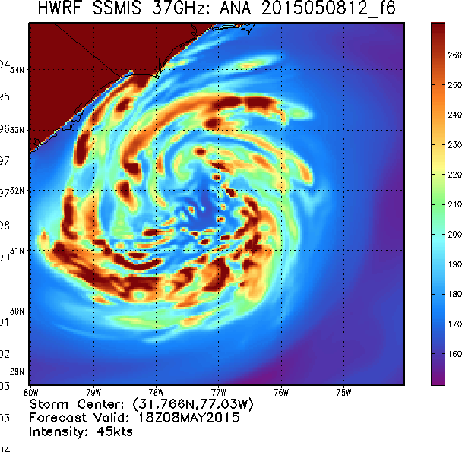
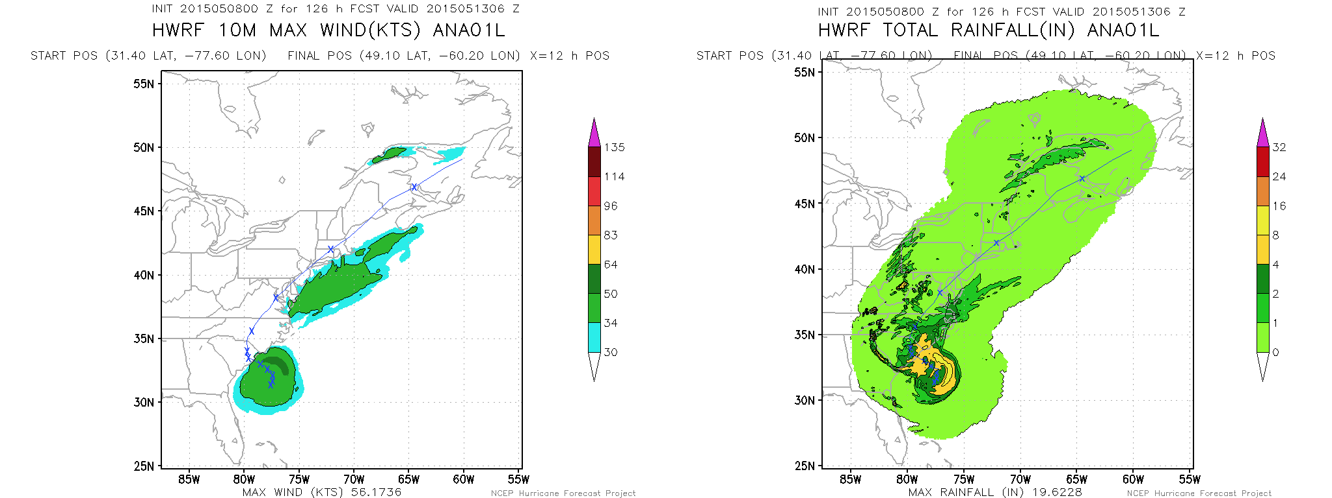
Standard HWRF Forecast Products
ATCF text files from GFDL Vortex Tracker
Grib2 files of standard and synthetic satellite fields on combined and single grids, at various resolutions
Swath rain and wind products
HWRF Real-time Operational Website
http://www.emc.ncep.noaa.gov/gc_wmb/vxt/

Slide 21
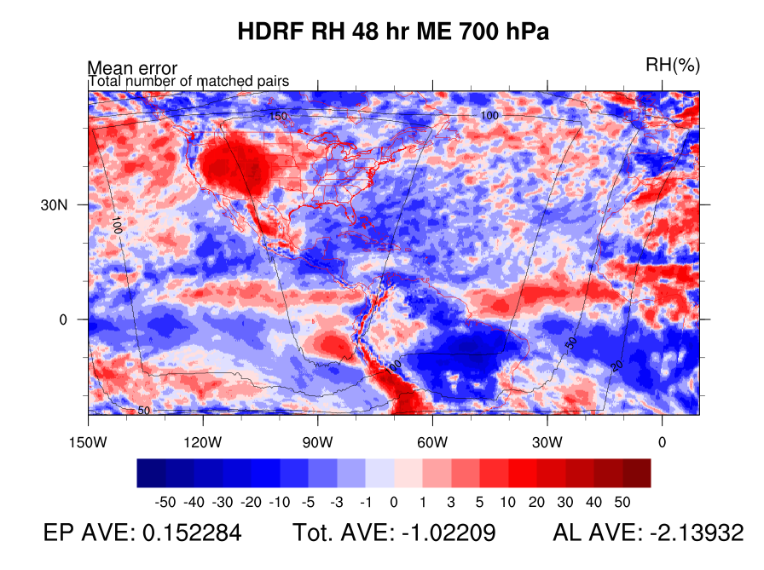
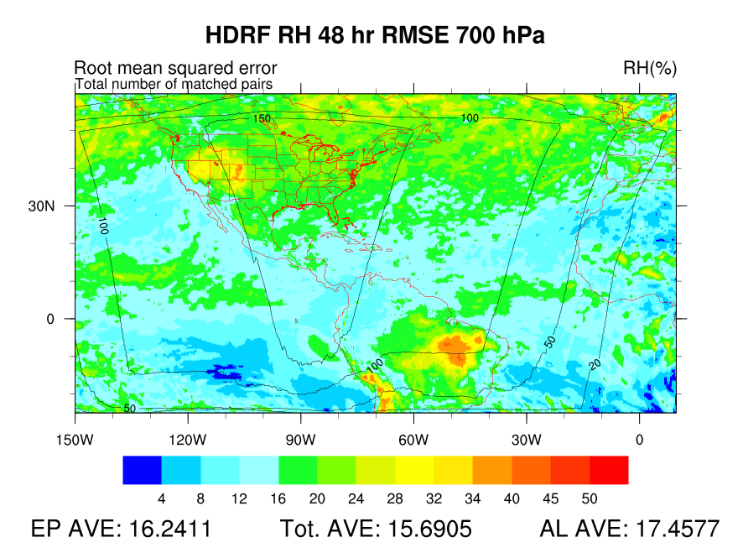
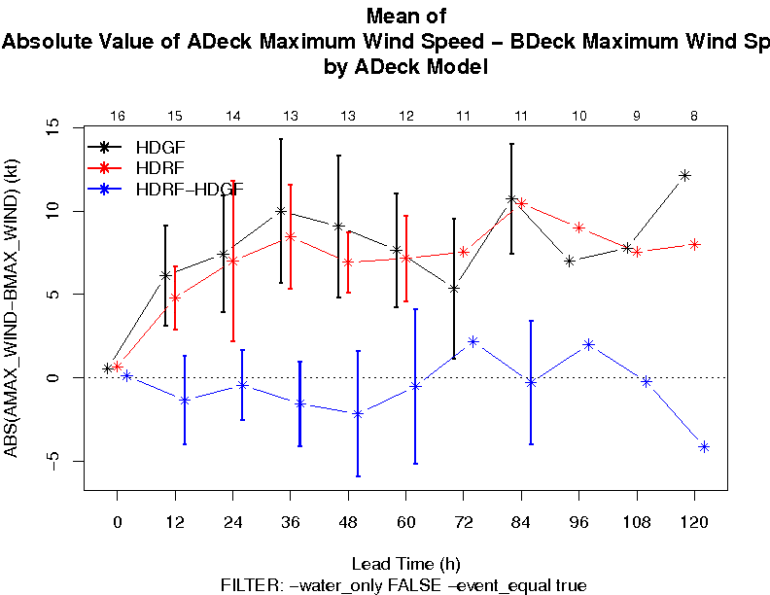
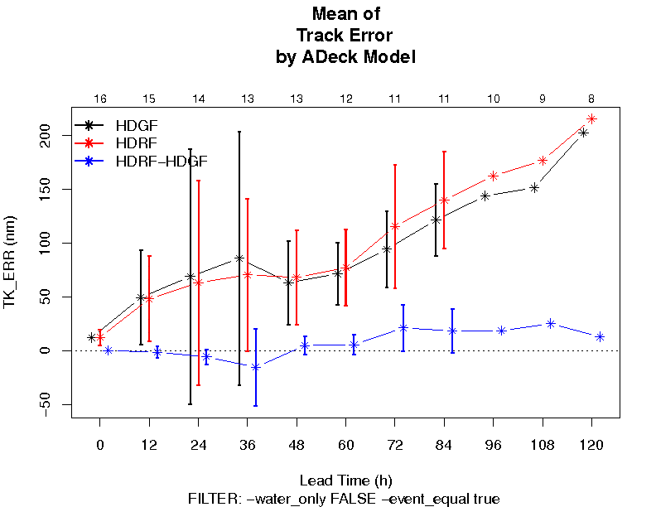
Model Evaluation Tools (MET)
MET and MET-TC are comprehensive verification tools supported at the DTC
MET Series Analysis tool can be used to generate large-scale statistics over a large region
MET-TC is used to generate statistics from the ATCF output files
Get MET here…
http://www.dtcenter.org/met/users/

